Slide 1
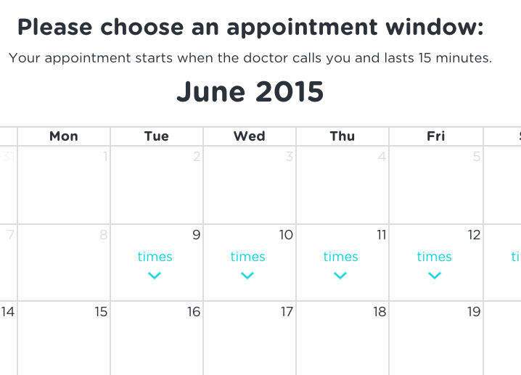
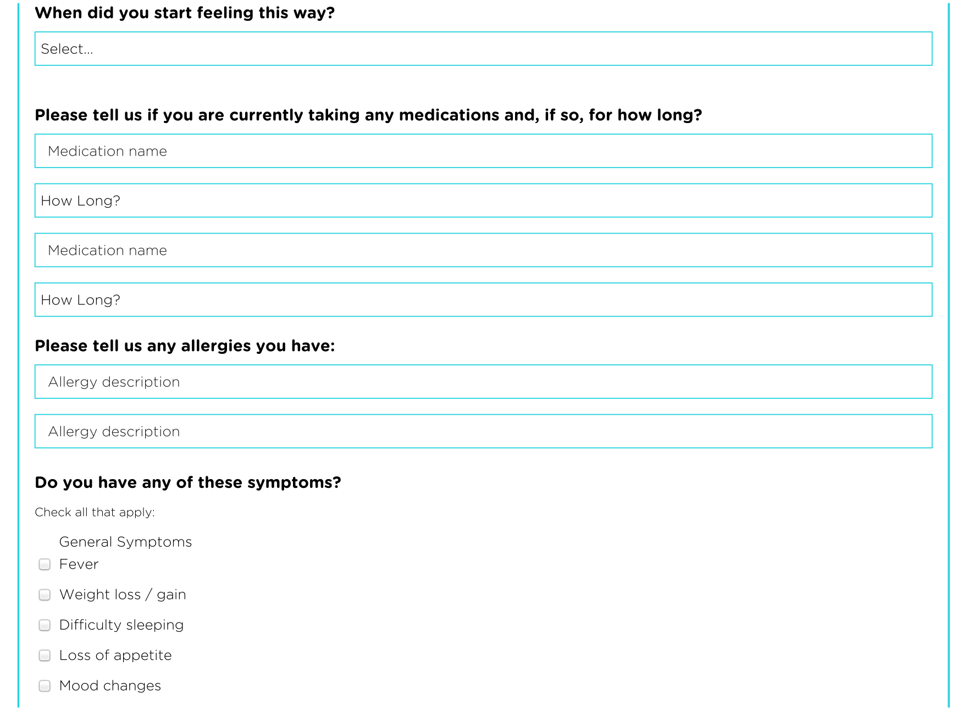
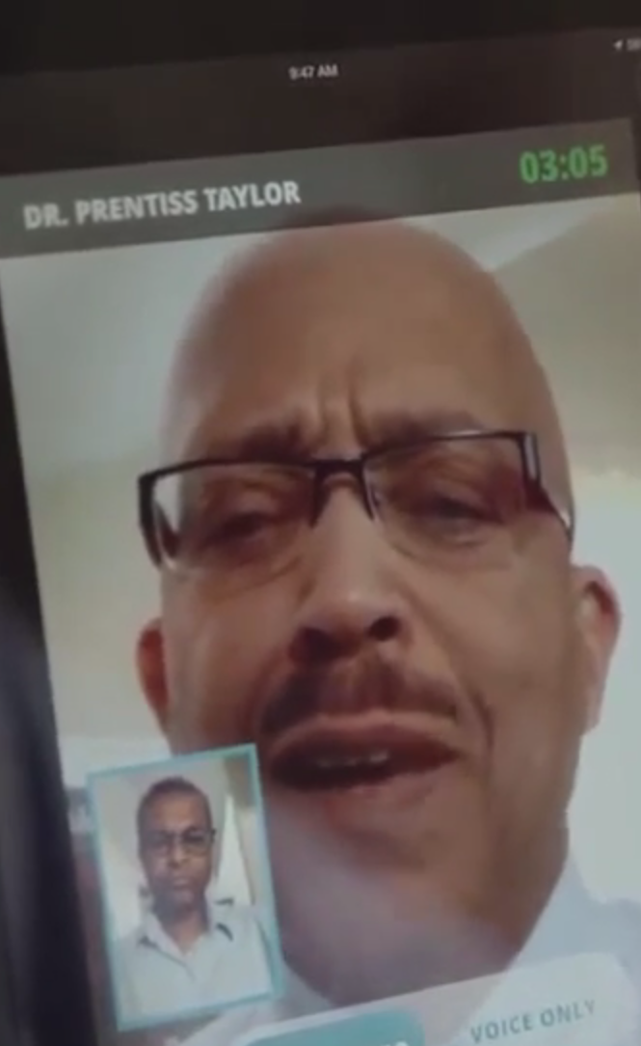
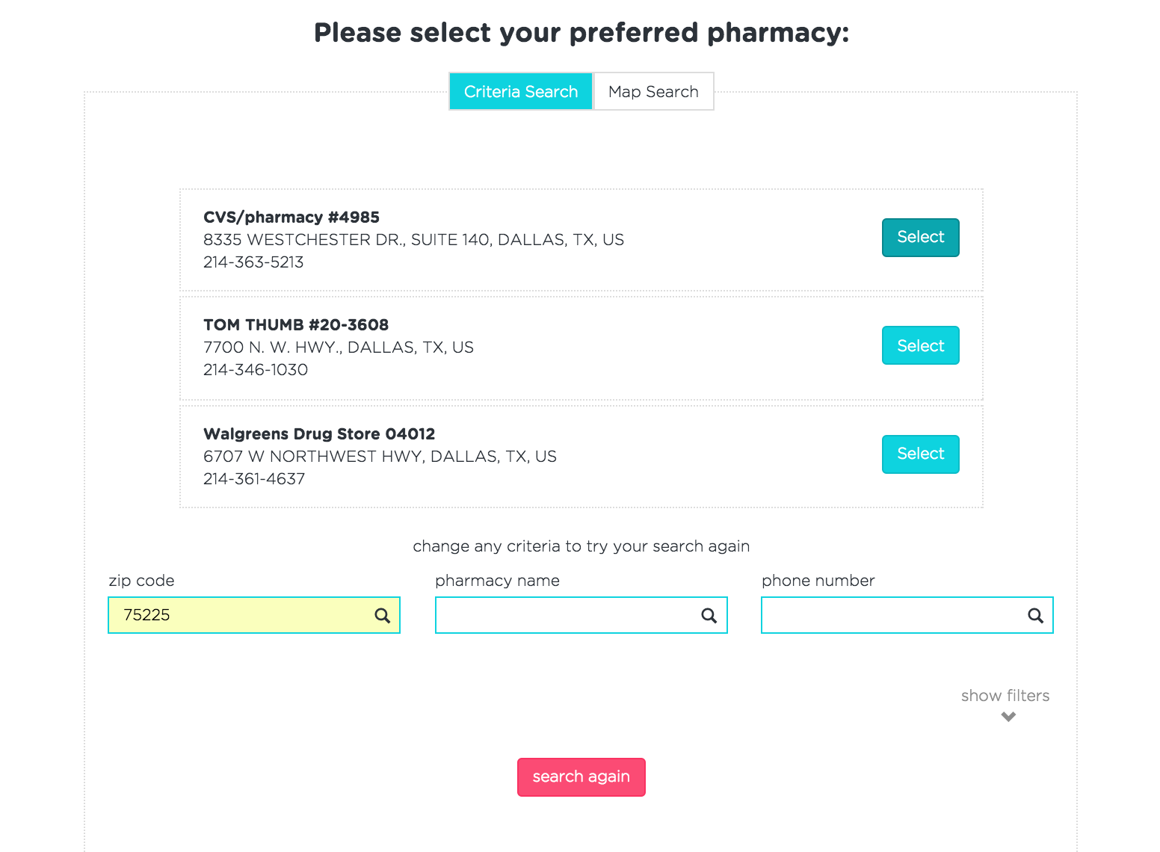

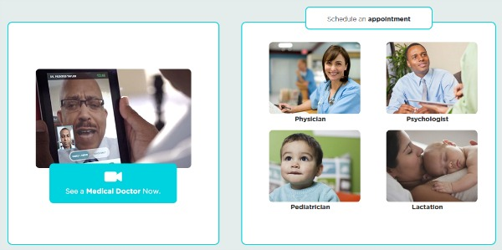
Enter Symptoms
We’ve developed a list of key symptom & history questions, specific to South African patients, that ensures time with your doctor is spent only on diagnosis, not data extraction.
See a Doctor
You have the option of seeing a doctor now or scheduling an appointment for later in the day or week. If you wish to see a doctor now but one is not available, you will be given a discount on your scheduled appointment.
Choose Pharmacy
If your doctor has prescribed a medication for you, we will send the script to your chosen pharmacy so it will be ready for pick-up at your convenience.
Pay By Consult & Refund Guarantee
While you’ll have entered your payment information before your consult, you will not be charged until after the consult finishes successfully. And if you are not completely satisfied with your service, we will give you a full refund.

Slide 2









Why Awesome?
Convenient
No longer miss work, wade through traffic, or wait in reception to see your doctor.
Low Cost
Pay less than you would for the same time with a South African private doctor.
High Quality
Our rigorous doctor selection & feedback process ensures the highest quality care.
Resilient
Don’t worry about low bandwidth & power outages – we’ve got it covered.
Low Data
Our platform uses less data for tasks & video – saving you money on your internet bill.
Secure
Your video stream is encrypted ensuring your visit is kept private, unlike Skype.
24/7 Access
Your child is sick at 1am & you don’t know who to call? We’re here for you.
Made4You
Our platform was developed hand-in-hand with African doctors & patients.
Private
If you wish to remain anonymous, you can not disclose your name & limit video.

Slide 3

Why Awesome?
Convenient
No longer miss work, wade through traffic, or wait in reception to see your doctor.
Low Cost
Pay less than you would for the same time with a South African private doctor.
High Quality
Our rigorous doctor selection & feedback process ensures the highest quality care.
Secure
Your video stream is encrypted ensuring your visit is kept private, unlike Skype.
Resilient
Don’t worry about low bandwidth & power outages – we’ve got it covered.
Low Data
Our platform uses less data for tasks & video – saving you money on your internet bill.
24/7 Access
Your child is sick at 1am & you don’t know who to call? We’re here for you.
Made4You
Our platform was developed hand-in-hand with African doctors & patients.

Slide 4
Why Awesome?
Convenient
No longer miss work, wade through traffic, or wait in reception to see your doctor.
Low Cost
Pay less than you would for a private doctor – it’s quality + affordable care.
High Quality
Our rigorous doctor selection & feedback process ensures the highest quality care.
Secure
Your video stream is encrypted ensuring your visit is kept private, unlike Skype.
Resilient
Don’t worry about low bandwidth & power outages – we’ve got it covered.
Low Data
Our platform uses less data for tasks & video – saving you money on your internet bill.
24/7 Access
Your child is sick at 1am & you don’t know who to call? We’re here for you.
Made4You
Our platform was developed hand-in-hand with African doctors & patients.

Slide 5

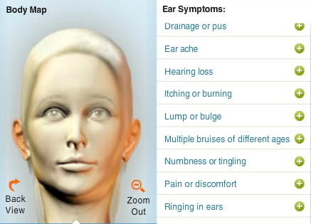

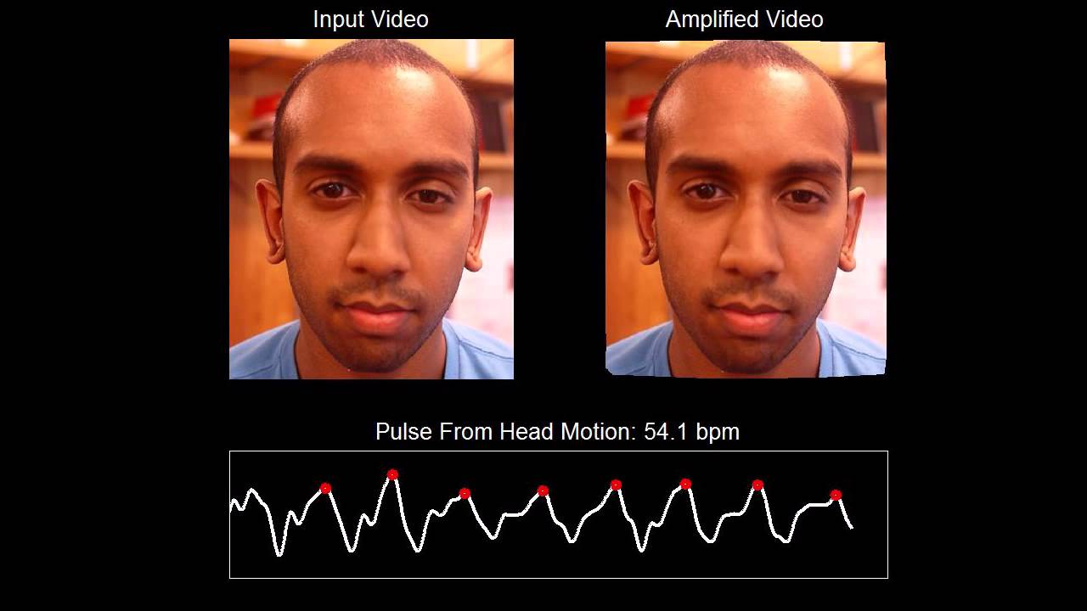
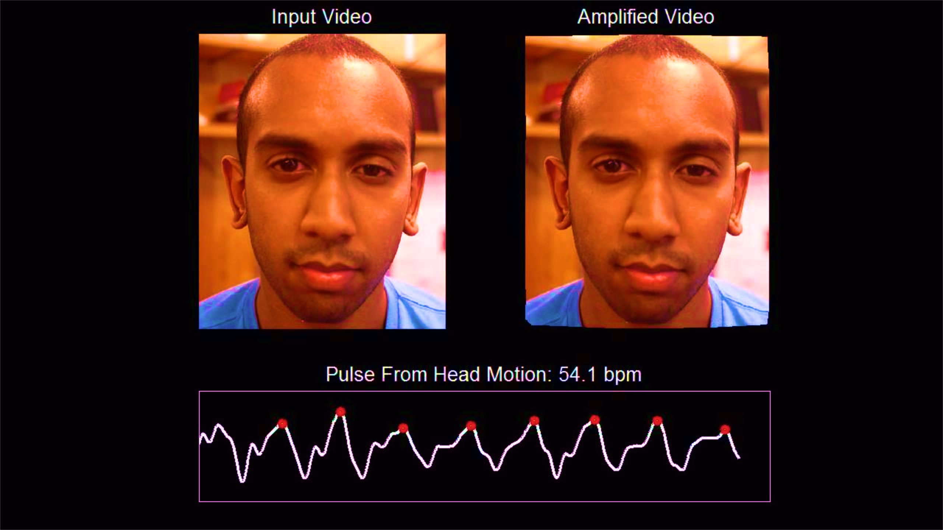

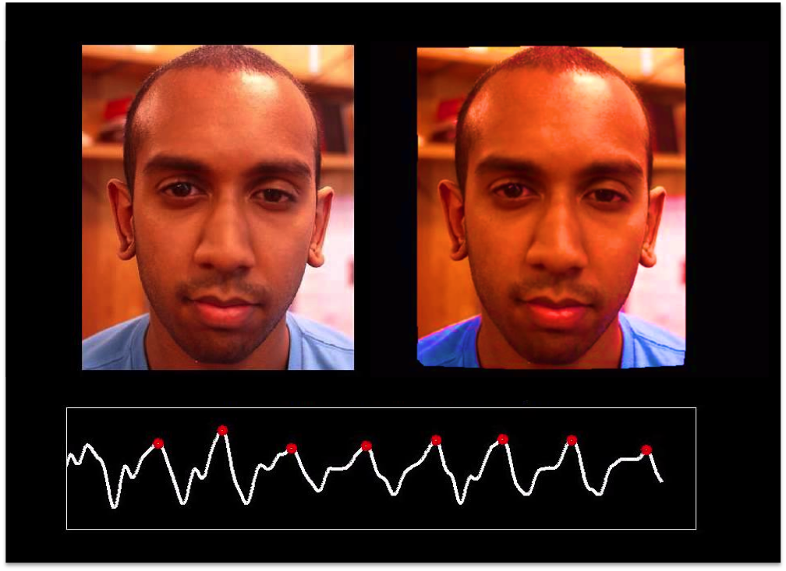

Machine Learning Products

Slide 6
Pricing & Projections
Revenue & Cost Projections
Pricing
Patient Price | $25 USD | 15% Less than Patient Price for Avg 30min Consult in SA
Doctor Cost | -$9 USD | Equal to SA Doctor Salary with 20+ yrs experience
65% Margin Per Consult
 | Yr1 | Yr2 | Yr3 | Yr4 | Yr5
Patient Price | $0.4 | $1.2 | $3.9 | $11.8 | $35.5
Doctor Cost | -$0.2 | -$0.4 | -$1.4 | -$4.3 | -$12.8
Overhead | -$0.1 | -$0.2 | -$0.2 | -$0.3 | -$0.4
Net Profit | $0.1 | $0.6 | $2.3 | $7.2 | $22.3
Yr5:
$22M Profit
Yr1:
Break Even
In $USD Millions

Slide 7
Market Research Insights
Market Size
$6 Billion
Africa – GP Visits for LSM7-10
Total Addressable Market
“Fastest growing middle class in the world”
$900 Million
South Africa – GP Visits for LSM7-10
Segmented Addressable Market
South Africa – GP Visits for LSM7-10
+ Interested in Telemedicine
Share of Market
$600 Million

Slide 8



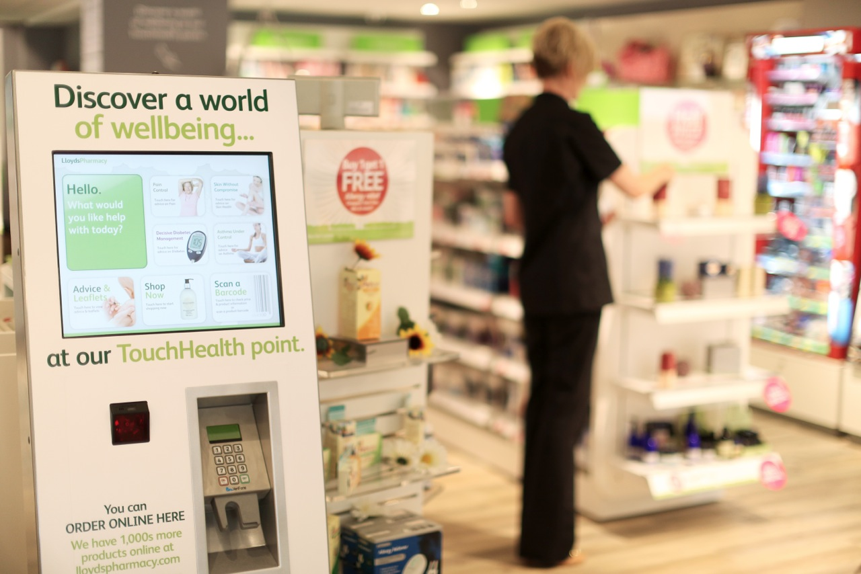
Growth Opportunities
Specialists & Nurse Practitioners
Enterprise Software
Machine Learning
Medical Tools
Healthcare
Hubs
We can license out our platform to private practices for use with their own patients.
We can develop new machine learning medical tools as I’ve just mentioned.
We can have specialists like psychiatrists or offer nurse practitioners at a lower cost.
we can partner with governments and NGOs to develop healthcare hubs so those without technology can use the service.

Slide 9


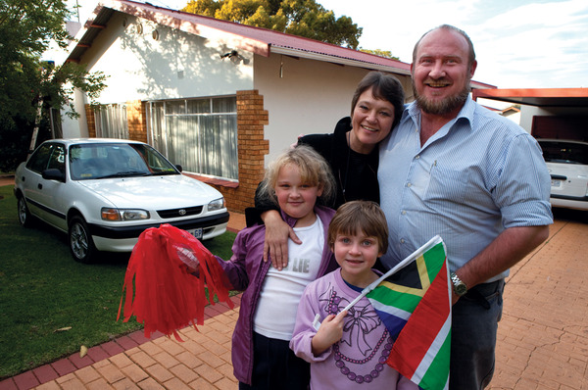



This last point is most important because it truly speaks to our mission. Our strategy is to first target middle & upper income groups to generate the traction and revenue needed to then generate lower income populations.
Mission
Enable all Africans to live healthier, longer, & happier lives.

Slide 10

Mission
DevTech
Making Impact with Tech

Slide 11
Timeline
Pilot: Sept ‘15
Our Pilot
Raising $250k
Seed Funds
Alpha:
July ‘16
Employees
2 developers, 1 Marketing & Sales
Legal Fees
Liability Analysis (mostly pro-bono), Corporate Setup
Insurance
Malpractice & Liability
Tech Infrastructure
Servers, Data Storage, Dev Software

Slide 12

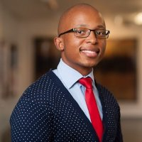
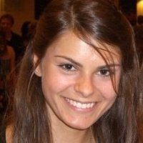

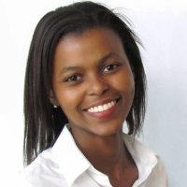
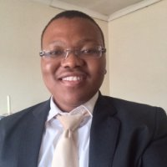
Team
Dr. Vuyane Mhlomi
Medical Doctor
Melissa McCoy
Software Engineer
Zikho Pali
Lawyer
Thula Siluma
Business Consultant

Slide 13

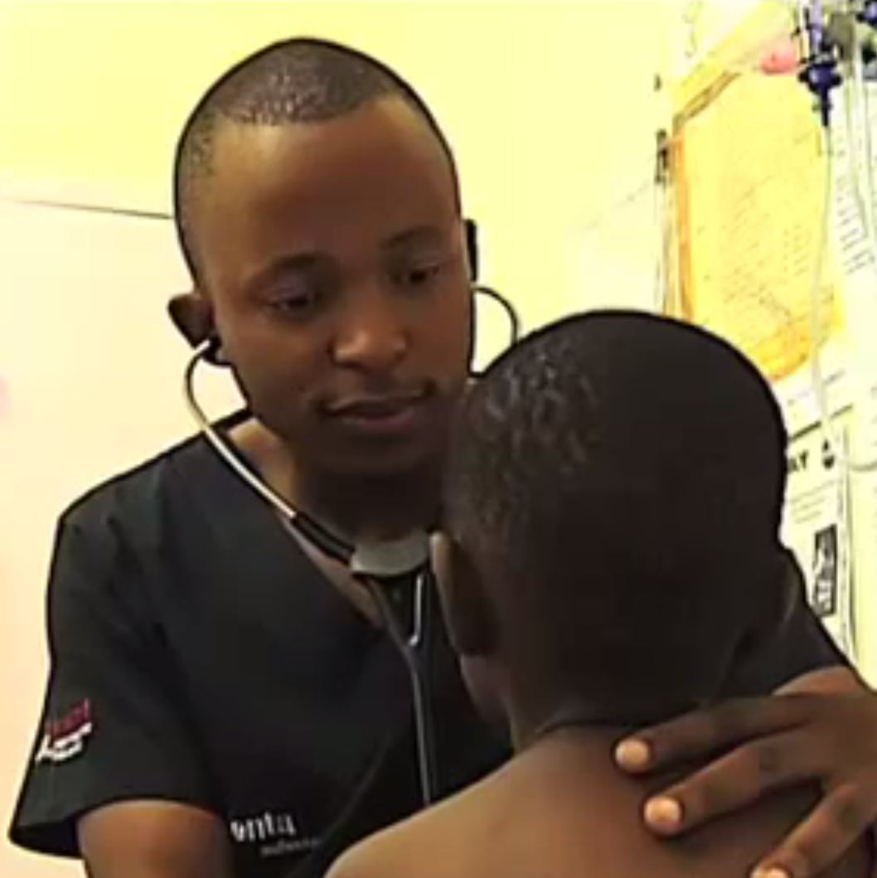



Contact
$
$

Slide 14






DevTech
Making Impact with Tech
ConnectMed
DevTech
Africa’s Online Medical Practice
Making Impact with Tech

Slide 15





Melissa McCoy
MSc Computer Science & MBA 2016 Candidate || University of Oxford
CEO & Co-Founder || ConnectMed - Africa’s Online Medical Practice
Lead Engineer & Founder || DevTech - Making Impact with Tech
Phone: +44 | Email:
MSc Computer Science 2015
MBA 2016 Candidate
melissa-mccoy@gtc.ox.ac.uk
CEO & Co-Founder
melissa@connectmed.co.za
Lead Engineer & Founder
melissa@devtech.com

